Slide 1
Electronic Voting Machine using ARDUINO UNO
Team Members:
Bhavani B M (1PE15CS038)
G L Priya (1PE15CS054)
Akshita M (1PE15CS016)

Slide 2
Introduction:
Our main idea is to implement an EVM(Electronic Voting Machine) using an Arduino UNO to store, calculate and display the result of the votes casted by people. Key Features of the EVM are listed as follows:
Every step of polling operation is under control of the supervisor.
Password enabled security system.
Poll results can be obtained instantly.
Voter will be aware of the candidate he is voting for.

Slide 3
Components required:
1. Arduino UNO : 1
2. 16x2 LCD : 1
3. Push Buttons : As required
4. Potentiometer 100k : 1
5. Bread Board : 1
6. Power supply
7. Connecting wires : As required

Slide 4
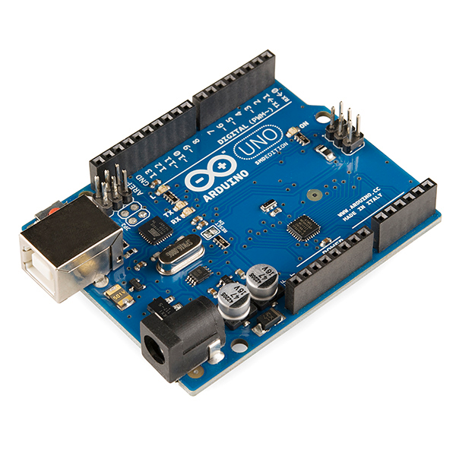
Arduino UNO
Arduino Uno is a microcontroller board based on the ATmega328P .
It has 14 digital input/output pins (of which 6 can be used as PWM outputs), 6 analog inputs, a 16 MHz quartz crystal, a USB connection, a power jack, an ICSP header and a reset button.
It contains everything needed to support the microcontroller; simply connect it to a computer with a USB cable or power it with a AC-to-DC adapter or battery to get started.

Slide 5
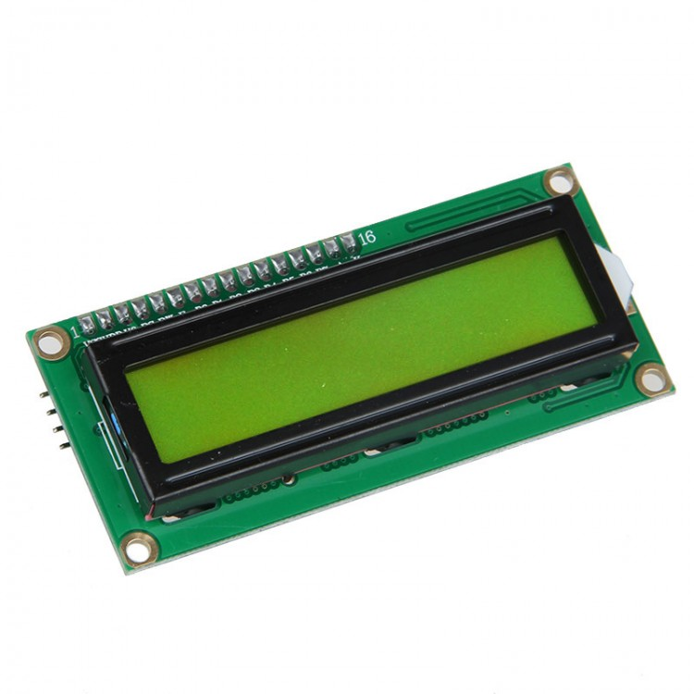
LCD(Liquid Crystal Display):
LCD screen is an electronic display module
LCD 16x2 means it can display 16 character per line and there are such 2 lines in this LCD
In this 16x2 LCD we have 16 pins which should be connected to Ardunio
16 pins are:
1: Vss 4: RS 7-14: [Data Bits(0-7)]
2: Vdd 5: R/W 15: A(LED+)
3: Constrast 6: E 16: K(LED-)

Slide 6
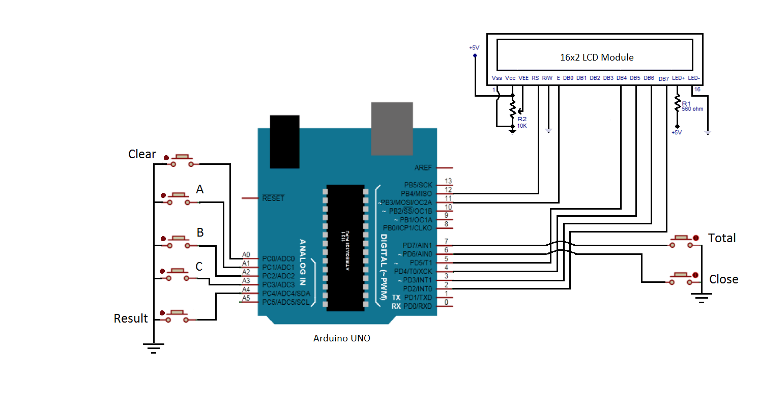
Circuit Diagram:

Slide 7
Block Diagram:
16*2 LCD Display
Control lines
Data lines
Result
PARTY-A
MICROCONTROLLER
(ATMEGA 328)
Close
PARTY-B
Total
PARTY-C
Clear

Slide 8
Working:
The electronic voting machine has two parts:-
Control Unit : It stores all the votes in the memory and is generally battery operated. Moreover it also contains important buttons like result, close, print, clear.
Ballot Unit : It contains buttons of the contesting parties. A connecting cable is used for connecting ballot unit with the control unit.
Three buttons are provided for the three contesting parties (PARTY-A , PARTY-B, PARTY-C). Voters can use these buttons to vote for their party. So these three buttons are accessible to the voters. Voters are not given the access of the rest of the four buttons.
Total button can be pressed any time to get the count of the total number of votes that are polled so far.
Close button if pressed closes the voting process and if this button is pressed then PARTY-A, B and C buttons will become in effective and pressing of these three buttons will not have any effect on the system. Once close button is pressed, Result button can be pressed to check the results of the poll.
Once Result button is pressed the machine will tell you the exact number of votes that are polled for each of the three contesting parties and it will also tell the result of the poll that is which party has won the election.

Slide 9
The machine is programmed to also indicate the vote difference between the winning party and the first runner up party.
In case tie happens between any two parties, or between all three contesting parties then the machine will show the tie result on the LCD screen.
Clear button is also provided and if this button is pressed then entire memory of the machine gets empty and all the stored vote count becomes zero. So clear and total button can be pressed any time during the voting process .
If these buttons are pressed corresponding action that is programmed into the system will happen.
Close button must be pressed before result button is pressed to get the result.
The vote count is saved in the on chip EEPROM of the Arduino and so if power cut occurs then also the votes that are entered into the system will remain safe and again when the system is powered up the voting will begin from the previous state.

Slide 10
Snapshots of the prototype

Slide 11
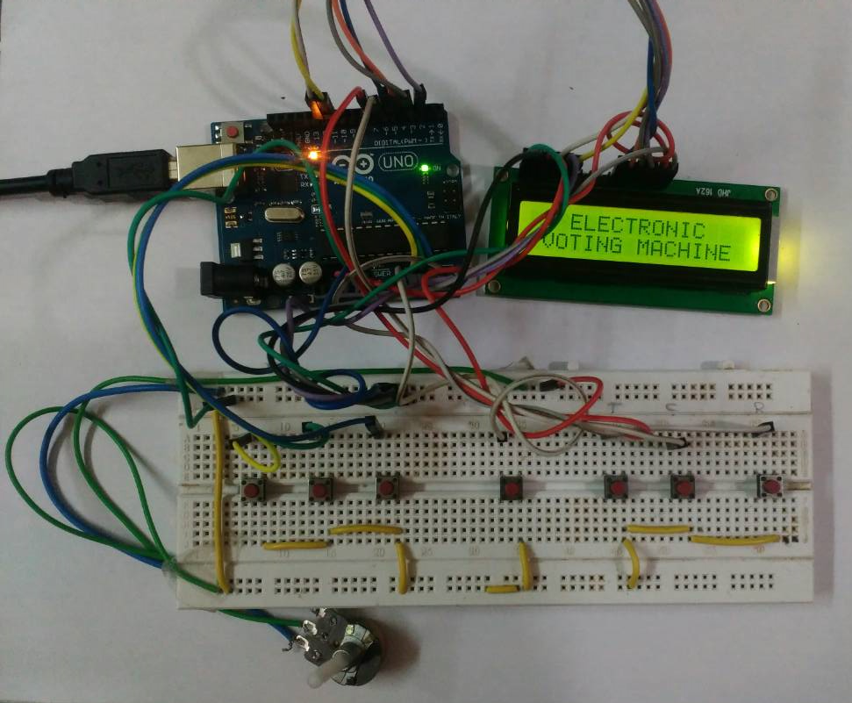
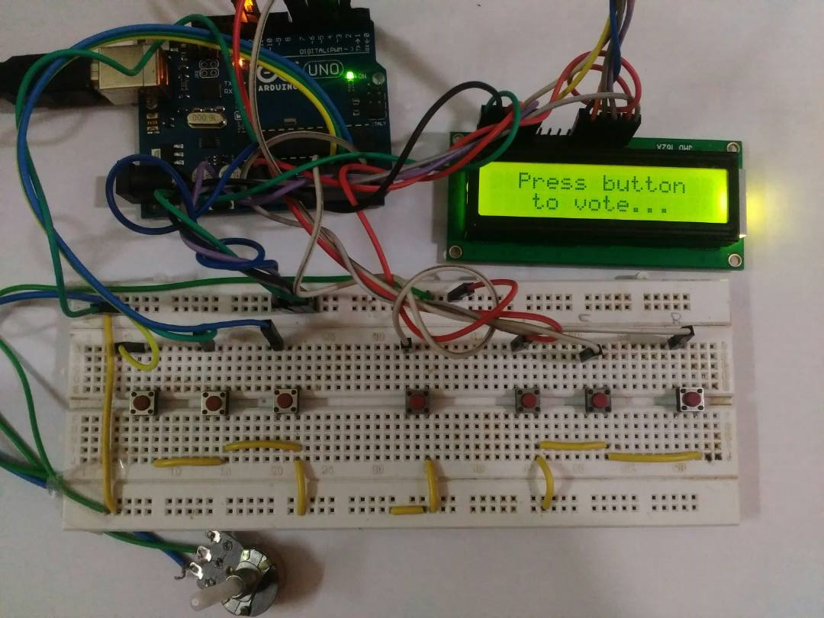
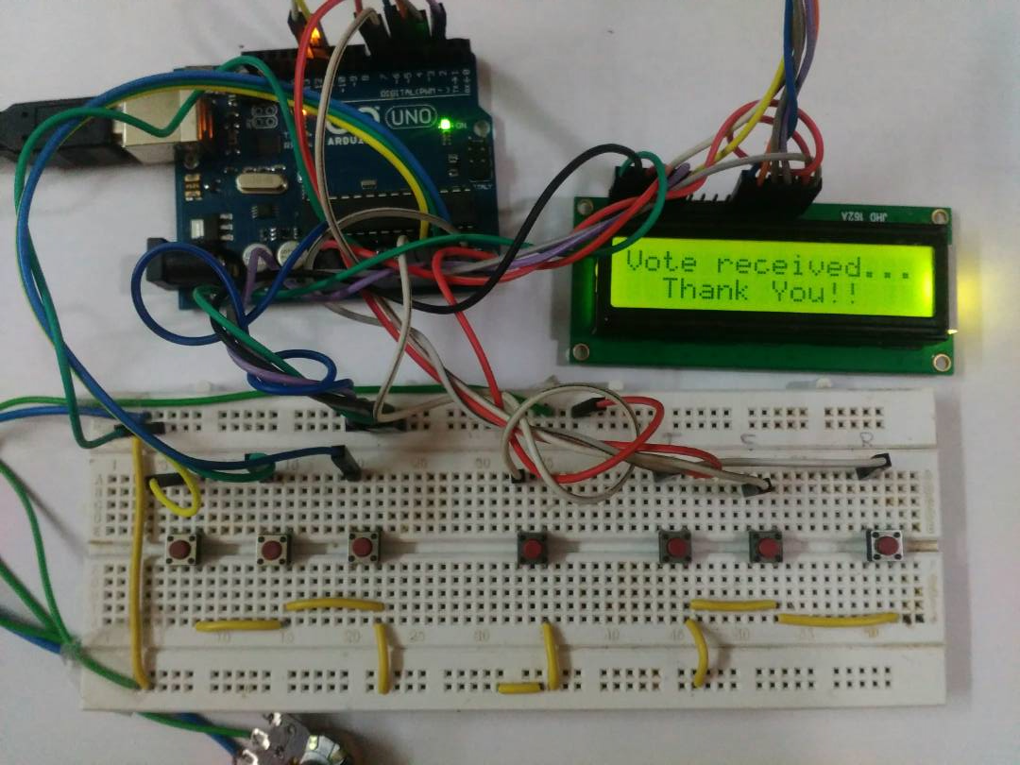
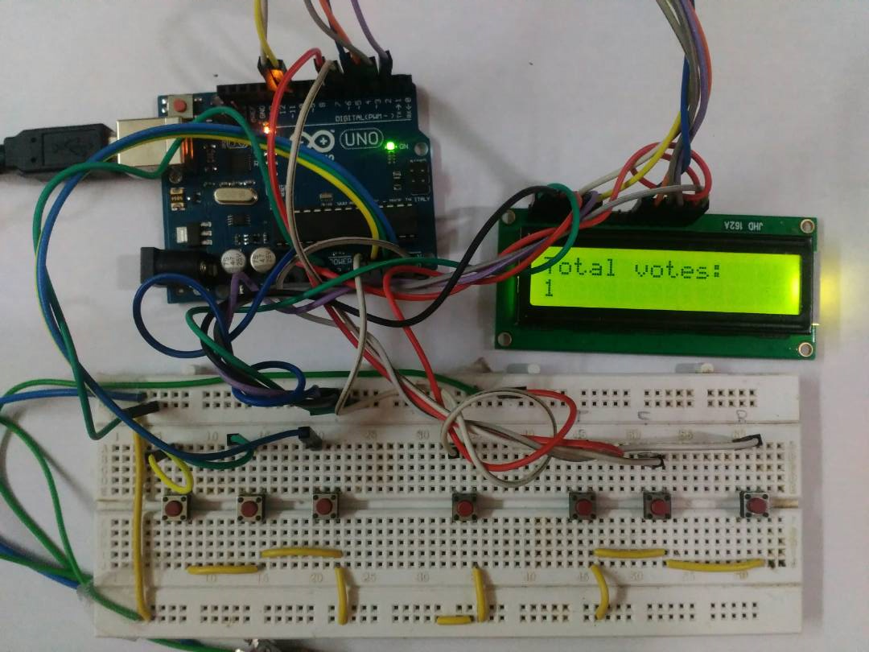

Slide 12
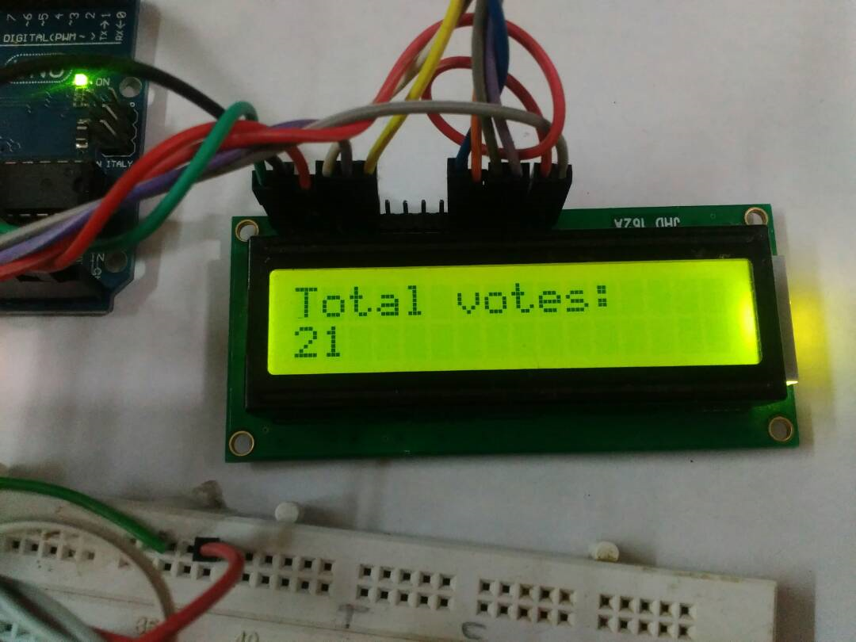
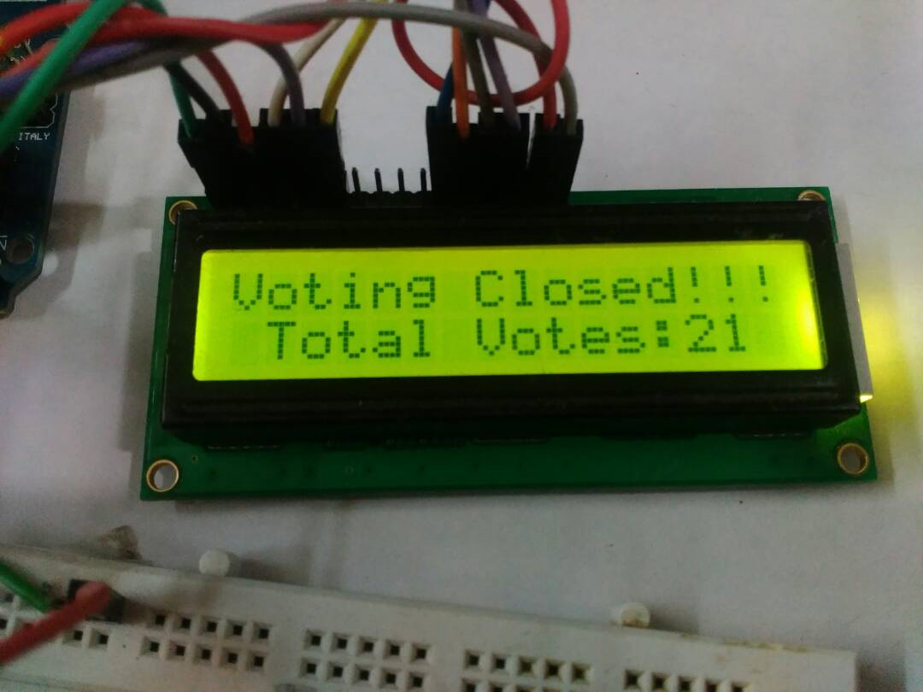
TOTAL button
CLOSE button

Slide 13
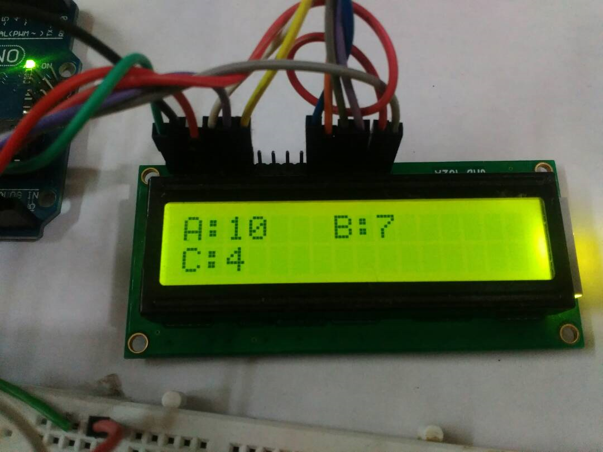
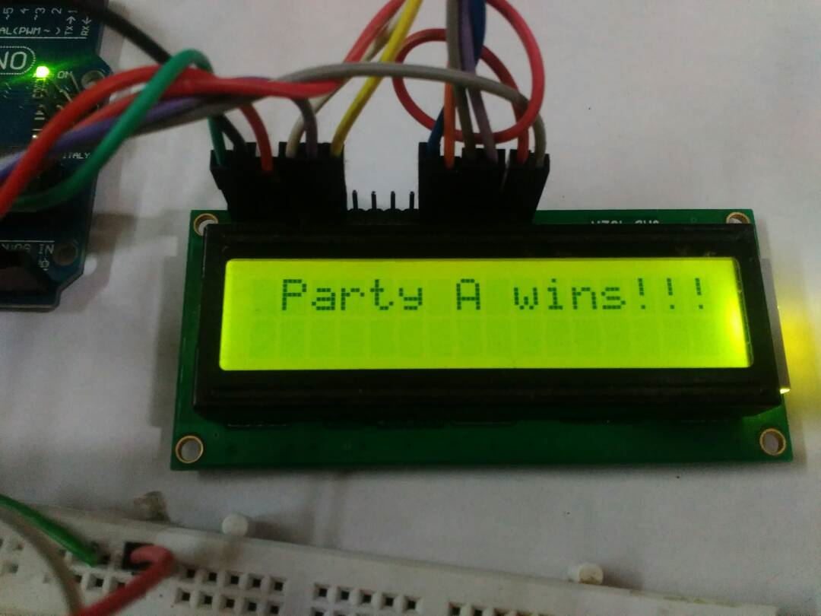
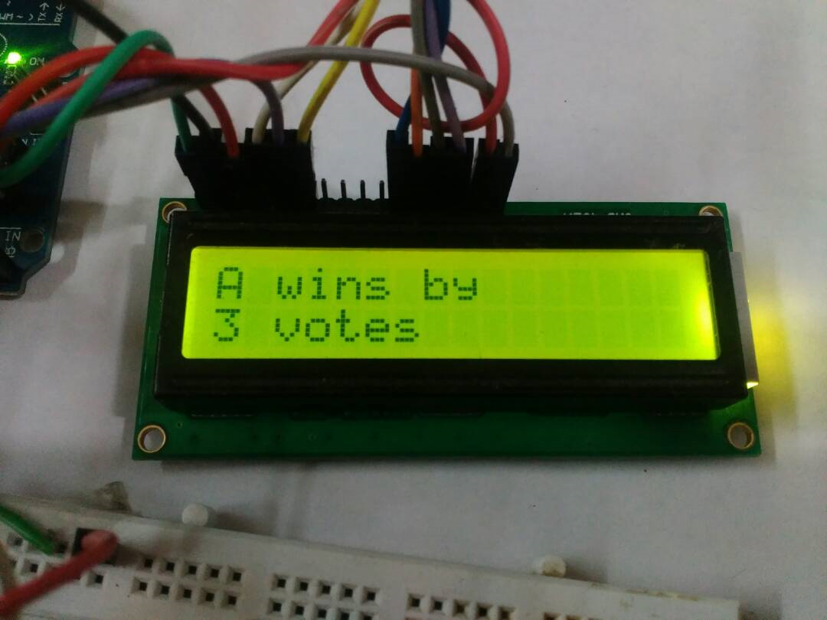
RESULT button

Slide 14
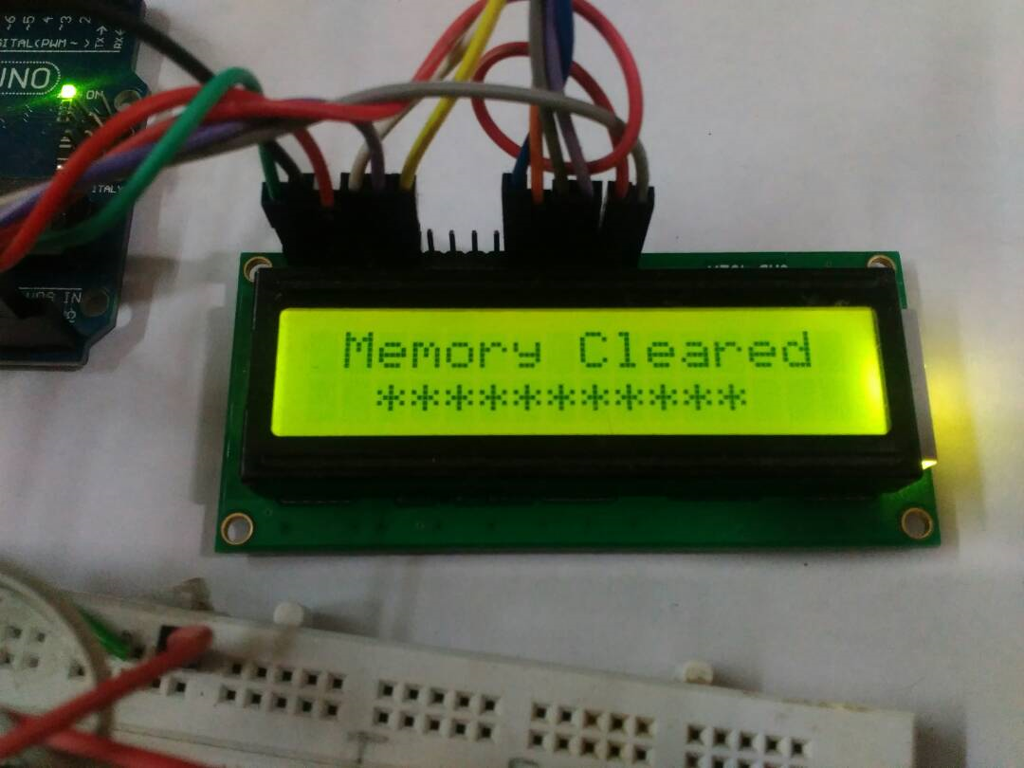
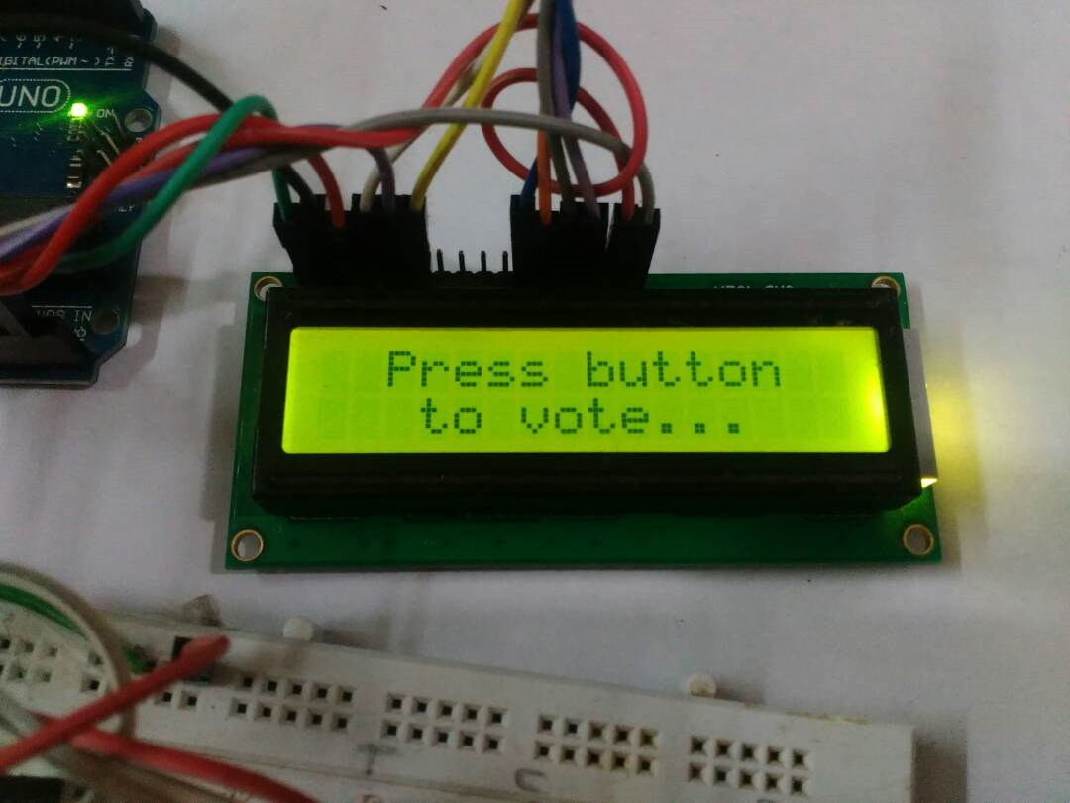
CLEAR button

Slide 15
CODE

Slide 16
/*This code accepts the votes obtained from the EVM, computes the total, displays the winning party along with the number of votes by which it has won, on the Liquid Crystal Display. Using EEPROM, the polling data is saved even if the power supply is interrupted and also clears the memory when the clear button is pressed*/ #include<LiquidCrystal.h> // lcd library #include <EEPROM.h> //EEPROM library LiquidCrystal lcd(12, 11, 5, 4, 3, 2); // LCD control and data lines int result=A4; // button pin definitions int closed=6; int total=7; int clearbutton=A0; int a=A1; int b=A2; int c=A3; int v1; // temporary variables used in program int v2; int v3; int v; | int cflag; void setup() { cflag=EEPROM.read(0); //read the status of cflag from memory v1=EEPROM.read(1);// v1 stores the vote count of party A v2=EEPROM.read(2); // v2 stores the vote count of party B v3=EEPROM.read(3); // v3 stores the vote count of party C pinMode(a,INPUT); // declaration of buttons as input pinMode(b,INPUT); pinMode(c,INPUT); pinMode(total,INPUT); pinMode(closed,INPUT); pinMode(result,INPUT); pinMode(clearbutton,INPUT); digitalWrite(a,HIGH); //default status of buttons when not pressed is high digitalWrite(b,HIGH);

Slide 17
digitalWrite(c,HIGH); digitalWrite(total,HIGH); digitalWrite(closed,HIGH); digitalWrite(result,HIGH); digitalWrite(clearbutton,HIGH); lcd.begin(16,2); if(cflag==0) { lcd.print(" ELECTRONIC"); lcd.setCursor(0,1); lcd.print(" VOTING MACHINE"); delay(5000); lcd.clear(); lcd.print(" Press button"); lcd.setCursor(0,1); lcd.print(" to vote..."); delay(1000); } if(cflag==1) { lcd.clear(); lcd.setCursor(0,0); | lcd.print(" Voting Closed"); lcd.setCursor(0,1); v=v1+v2+v3; lcd.print("Total Votes:"); lcd.print(v); } } void rpt() { lcd.clear(); lcd.setCursor(0,0); lcd.print(" Press button"); lcd.setCursor(0,1); lcd.print(" to vote..."); } void votedifference() // function to calculate vote difference { if(v1>v2) { if(v2>v3)

Slide 18
{ lcd.clear(); lcd.setCursor(0,0); lcd.print("A wins by"); lcd.setCursor(0,1); lcd.print(v1-v2); lcd.print(" votes"); } else { if(v1>v3) { lcd.clear(); lcd.setCursor(0,0); lcd.print("A wins by"); lcd.setCursor(0,1); lcd.print(v1-v3); lcd.print(" votes"); } if(v1<v3) { lcd.clear(); | lcd.setCursor(0,0); lcd.print("C wins by"); lcd.setCursor(0,1); lcd.print(v3-v1); lcd.print(" votes"); } } } else { if(v1>v3) { lcd.clear(); lcd.setCursor(0,0); lcd.print("B wins by"); lcd.setCursor(0,1); lcd.print(v2-v1); lcd.print(" votes"); } else {

Slide 19
if(v2>v3) { lcd.clear(); lcd.setCursor(0,0); lcd.print("B wins by"); lcd.setCursor(0,1); lcd.print(v2-v3); lcd.print(" votes"); } if(v2<v3) { lcd.clear(); lcd.setCursor(0,0); lcd.print("C wins by"); lcd.setCursor(0,1); lcd.print(v3-v2); lcd.print(" votes"); } } } } | void loop() { if(digitalRead(a)==LOW && cflag==0) // if party A button is pressed { v1=v1+1; EEPROM.write(1,v1); lcd.clear(); lcd.setCursor(0,0); lcd.print("Vote received..."); lcd.setCursor(0,1); lcd.print(" Thank You!!"); delay(1500); rpt(); } if(digitalRead(b)==LOW && cflag==0) // if party B button is pressed { v2=v2+1; EEPROM.write(2,v2); lcd.clear();

Slide 20
lcd.setCursor(0,0); lcd.print("Vote received..."); lcd.setCursor(0,1); lcd.print(" Thank You!!"); delay(1500); rpt(); } if(digitalRead(c)==LOW && cflag==0) // if party C button is pressed { v3=v3+1; EEPROM.write(3,v3); lcd.clear(); lcd.setCursor(0,0); lcd.print("Vote received..."); lcd.setCursor(0,1); lcd.print(" Thank You!!"); delay(1500); rpt(); } // if total button is pressed but close button was not pressed earlier | if(digitalRead(total)==LOW && cflag==0) { v=v1+v2+v3; lcd.clear(); lcd.setCursor(0,0); lcd.print("Total votes:"); lcd.setCursor(0,1); lcd.print(v); delay(2000); rpt(); } if(digitalRead(closed)==LOW) // if close button is pressed { cflag=1; EEPROM.write(0,cflag); lcd.clear(); lcd.setCursor(0,0); lcd.print("Voting Closed!!!"); lcd.setCursor(0,1); v=v1+v2+v3;

Slide 21
lcd.print(" Total Votes:"); lcd.print(v); while(digitalRead(result)==HIGH); } // if result button is pressed after the close button was pressed if(digitalRead(result)==LOW && cflag==1) { lcd.clear(); lcd.setCursor(0,0); lcd.print("A:"); lcd.print(v1); lcd.setCursor(7,0); lcd.print("B:"); lcd.print(v2); lcd.setCursor(0,1); lcd.print("C:"); lcd.print(v3); delay(3000); // logic for result of voting process if(v1==v2 && v2==v3) | { lcd.clear(); lcd.setCursor(0,0); lcd.print(" Result Tied!!!"); delay(3000); } if(v1==v2 && v1>v3) { lcd.clear(); lcd.setCursor(0,0); lcd.print("Tie b/w A and B"); delay(3000); } if(v2==v3 && v2>v1) { lcd.clear(); lcd.setCursor(0,0); lcd.print("Tie b/w B and C"); delay(3000); } if(v1==v3 && v1>v2) {

Slide 22
if(v1==v3 && v1>v2) { lcd.clear(); lcd.setCursor(0,0); lcd.print("Tie b/w A and C"); delay(3000); } if(v1>v2) { if(v1>v3) { lcd.clear(); lcd.setCursor(0,0); lcd.print(" Party A wins!!!"); delay(3000); votedifference(); } else if(v3>v1) { lcd.clear(); lcd.setCursor(0,0); lcd.print(" Party C wins!!!"); | delay(3000); votedifference(); } } else { if(v2>v3 && v1!=v2) { lcd.clear(); lcd.setCursor(0,0); lcd.print(" Party B wins!!!"); delay(3000); votedifference(); } else if(v3>v2) { lcd.clear(); lcd.setCursor(0,0); lcd.print(" Party C wins!!!"); delay(3000); votedifference(); }

Slide 23
} } if(digitalRead(clearbutton)==LOW) // if clear button is pressed { for (int i = 0; i < 512; i++) { EEPROM.write(i, 0); } v1=0; v2=0; v3=0; cflag=0; lcd.clear(); lcd.setCursor(0,0); lcd.print(" Memory Cleared"); lcd.setCursor(0,1); lcd.print(" *********** "); delay(3000); lcd.clear(); lcd.setCursor(0,0); lcd.print(" Press button"); | lcd.setCursor(0,1); lcd.print(" to vote..."); } }

Slide 24
Future Scope:
This project can be further extended in the following ways:
Interfacing a GSM modem with the machine for sending SMS to the mobile phone numbers of all the participating candidates/parties so that they can also get to know the result of each and every voting machine instantly.
A timer could be included, which could automatically end the voting after specified duration of time.
EVM can be made more interactive by adding Sound effect (speech) to it.
Biometric verification of voters, so that automatically it can be ensured that one person is voting only once.

Slide 25
Thank you!

